Slide 1
Software Life-Cycle Models
Life-cycle model (formerly, process model)
The steps through which the product progresses
Requirements phase
Specification phase
Design phase
Implementation phase
Integration phase
Maintenance phase
Retirement

Slide 2
Extreme Programming
Somewhat controversial new approach
Software development team determines the various features (Stories)
Estimate duration and cost of each feature
Client select features for next build using cost benefit analysis
Each build is divided into tasks
Test cases for task are drawn up first
Pair programming (working with a partner on one screen)
Continuous integration of tasks
Tasks are integrated into the current version of the product
Test cases used for the tasks are retained and utilized in all further integration testing

Slide 3
Unusual Features of XP
Computers are put in center of large room lined with small cubicles
Client representative is always present
No individual can work overtime for 2 successive weeks
No specialization. All members of XP team work on specifications, design, code and testing
There is no overall design is modified while the product is being built. The design is modified while product is being built. This procedure is known as refactoring.
XP has had some successes on small and medium sized projects
Good when requirements are vague or changing
Too soon to evaluate XP

Slide 4
Synchronize-and Stabilize Model
Microsoft’s life-cycle model
Requirements analysis—interview potential customers and extract a list of features with priorities set up by the customers
Draw up specifications
Divide project into 3 or 4 builds
First build consists of the most critical features, the second build consists of the next most critical features and so on.
Each build is carried out by small teams working in parallel

Slide 5
Synchronize-and Stabilize Model (contd)
At the end of the day all the teams—put together the partially completed components and synchronize (test and debug)
At the end of the build—stabilize (freeze build i.e. any remaining faults that have been detected are fixed).
Repeated synchronization steps ensure that the components always work together
Developers get early insights into operation of product and can modify the requirements.

Slide 6
Object-Oriented Life-Cycle Models
Need for iteration within and between phases
Fountain model
Recursive/parallel life cycle
Round-trip gestalt
Unified software development process
All incorporate some form of
Iteration
Parallelism
Incremental development

Slide 7
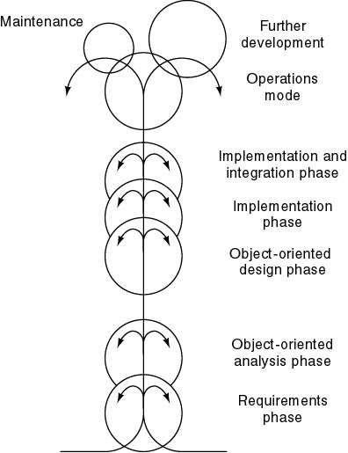
Fountain Model
Features
Overlap (parallelism)
Arrows (iteration)
Smaller maintenance circle

Slide 8
V Shaped Software Life cycle Model
There is a shift in testing activities from validation to verification where we want to review/inspect every activity of software development life cycle.
These verification activities are treated as error preventive exercises and are applied at requirements analysis and specification phase, high level design, detailed design phase, implementation phase.
We not only want to improve the quality of end products of all phases but also want to design test cases and test plans during these phases.
V shaped model is the modified form of waterfall model with a special focus on testing activities at every phase.

Slide 9
V Shaped Software Life cycle Model
A
Requirements Analysis and Specification
Acceptance Testing
B
High level design
System testing
C
Development Part
Unit and Integration testing
Detailed design
Testing Part
Implementation
A: Acceptance test cases design and planning
B: System test cases design and planning
C: Unit and integration test cases design and planning

Slide 10
V Shaped Software Life cycle Model
The model brings the quality into the development of our products
The encouragement of writing test cases and test plans in the early phases of software development life cycle is the real strength of this model.
We require more resources to implement this model as compared to waterfall model.
LIMITATIONS
This model suffers from many disadvantages of waterfall model like non availability of working version of the product until late in the life cycle, difficult to accommodate any change etc. this model has also limited applications in today’s iterative software processes

Slide 11
Conclusions
Different life-cycle models
Each with own strengths
Each with own weaknesses
Criteria for deciding on a model include
The organization
Its management
Skills of the employees
The nature of the product
Best suggestion
“Mix-and-match” life-cycle model

Slide 12
Conclusions
Life cycle model | Strengths | Weaknesses
Build and fix | Fine for short programs that will not require any maintenance | Totally unsatisfactory for nontrivial programs
Waterfall model | Disciplined approach Document driven | Delivered product may not meet client’s needs
Rapid prototype model | Ensure that delivered product meets client’s needs | Not yet proven beyond all doubt
Incremental model | Maximizes early return on investment Promotes maintainability | Requires open architecture May degenerate into build-and-fix

Slide 13
Conclusions
Life cycle model | Strengths | Weaknesses
Extreme programming | Maximizes early return on investment Works well when client’s requirement are vague | Has not yet been widely used
Synchronize and stablize model | Future user’s needs are met Ensures components can be successfully integrated | Has not been widely used other than Microsoft.
Spiral model | Incorporates features of all the models | Can be used only for large scale in-house products Developers have to be competent in risk analysis and risk resolution

Slide 14
Conclusions
Life cycle model | Strengths | Weaknesses
V shaped model | Incorporates testing at each phase | Usable product will be deliver very late
Object-oriented models | Support iteration within phases, parallelism between phases | May degenerate into code a bit test a bit (CABTAB)

